Slide 1

ASSIGENMENT – 2
Economic activity
BBA 1st SEM (2022-23)
Submitted By-
Shankh Bansal
AU22C1013
Submitted To-
Dr. Amber Tiwari

Slide 2
Purpose
Objectives
Learning outcomes
To know the value of money at very early stage rather spending like any other kid on the street.
You will never have any financial burden for sure at early age since you're needs will be minimal at that moment.

Slide 3
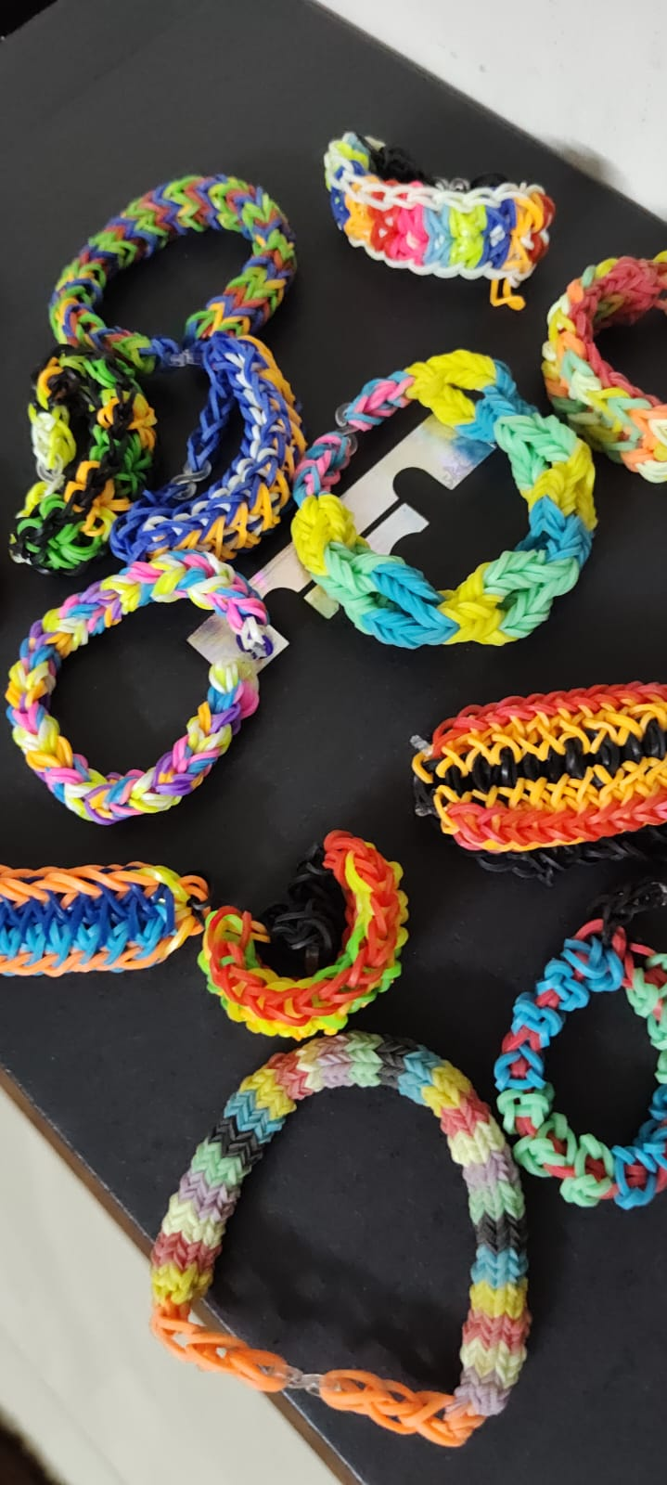
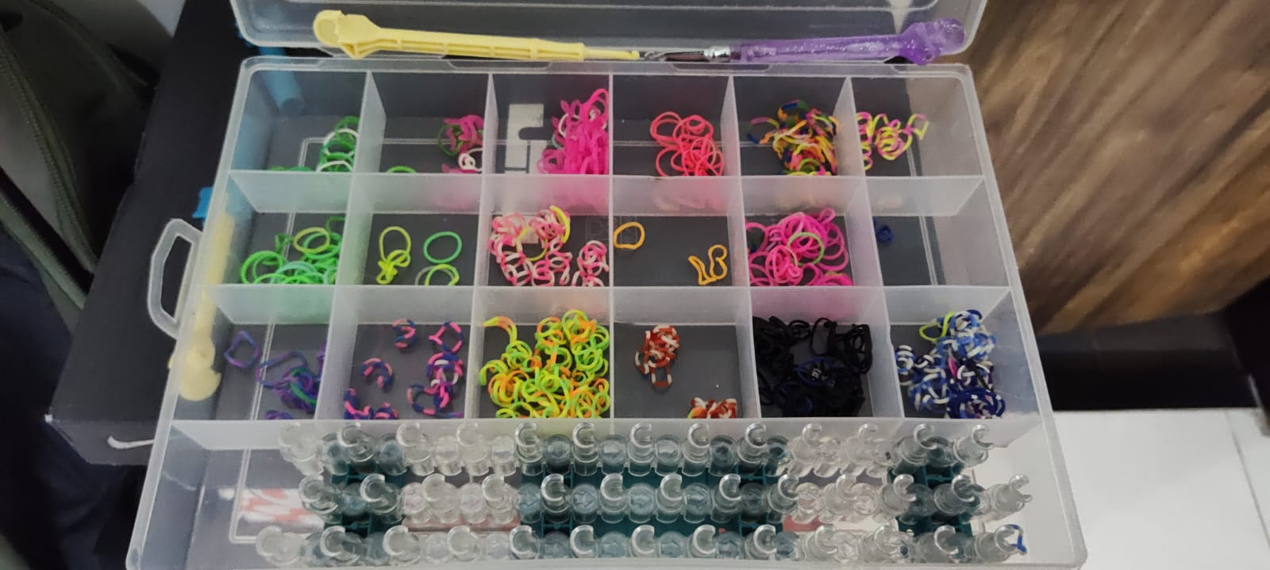

How did I earn?
Made a bracelet out of rubber band.
Which costed me around 15 Rs.
I sold it for 150 Rs.

